Slide 1
Assignment 1 Solutions

Slide 2
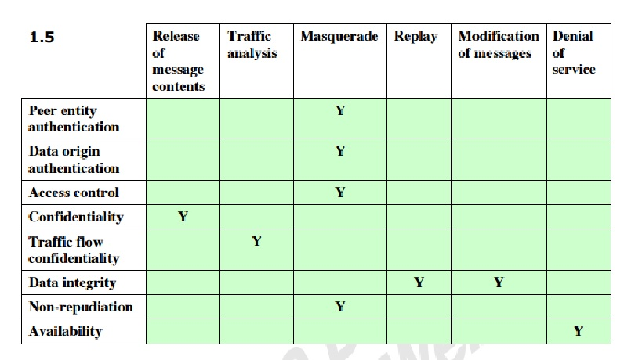
Problem 1.5
Draw a matrix similar to table to 1.4 that shows relationship between security services and attacks.

Slide 3
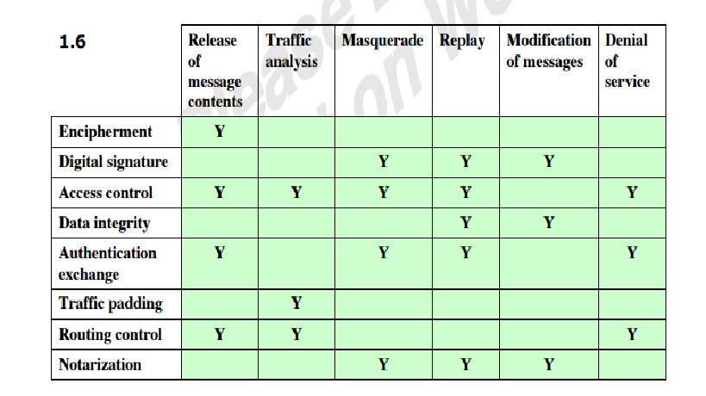
Problem 1.6
Draw a matrix similar to table to 1.4 that shows relationship between security mechanism and attacks.

Slide 4
Problem 2.3
For each of the following equations find an integer x that satisfies the equation.
a. 5*X ~ 4 mod 3 Ans -2
b. 7*X ~ 6 mod 5 Ans - 3
c. 9* X ~ 8 mod 7 Ans - 4

Slide 5
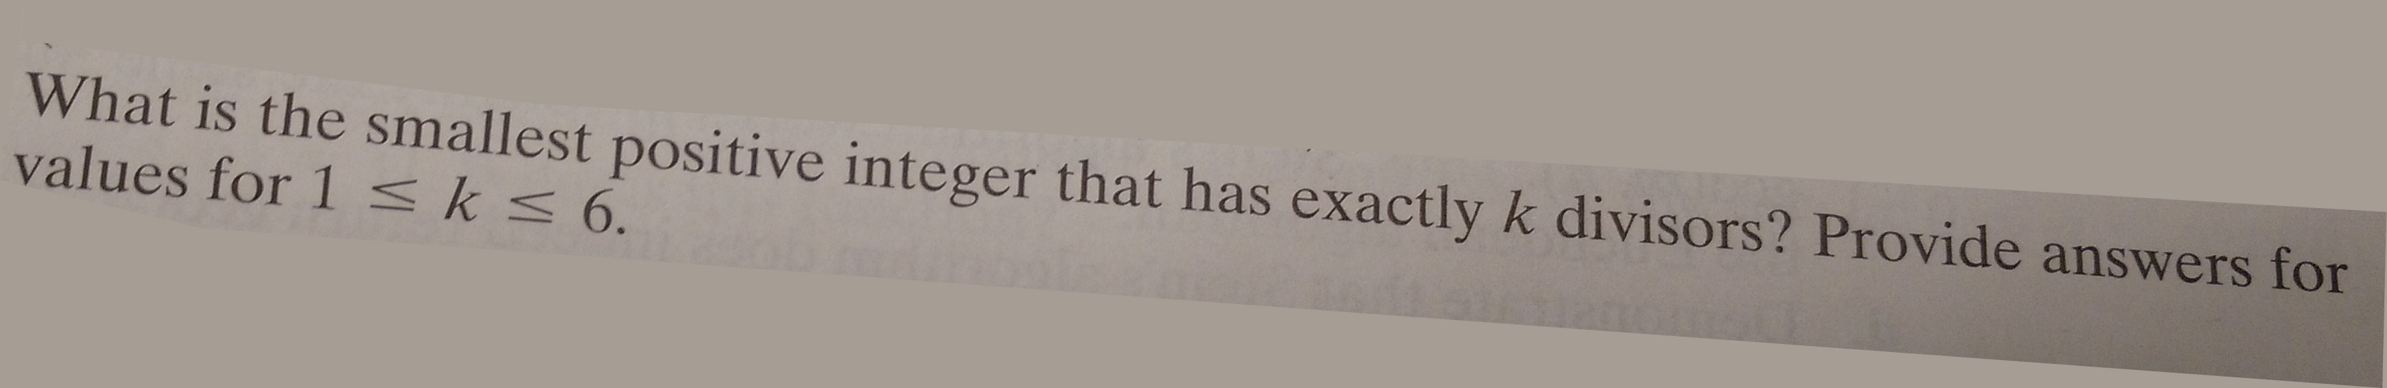
Problem 2.7
Ans - 1,2,4,6,16,12.

Slide 6
Problem 2.12
Determine a. gcd(24140,16762) Ans - 34
b. gcd(4655,12075) Ans - 35

Slide 7
Problem 2.16
Using the extended euclidean algorithm find multiplicative inverse of
a. 1234 mod 4321
Ans - 3239
b. 24140 mod 40902
Ans - No multiplicative inverse exists
c. 550 mod 1769
Ans - 550

Slide 8
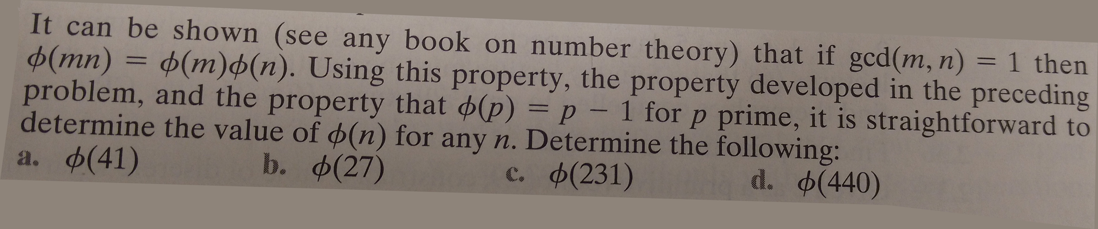
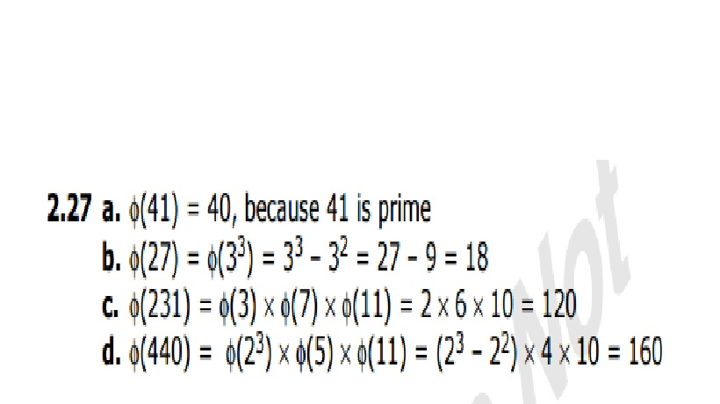
Problem 2.27

Slide 9
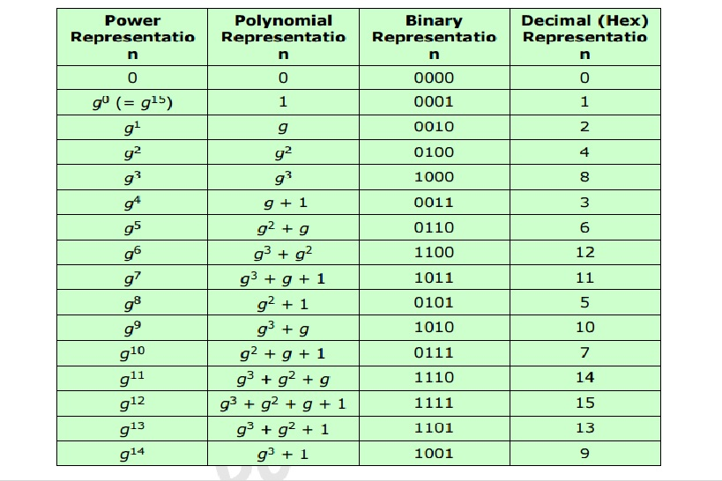
Problem 5.12
Develop a table similar to table 5.5 for GF (2^4) with m(x) = x^4 + x +1.(in lecture notes its x instead of g)

Slide 10
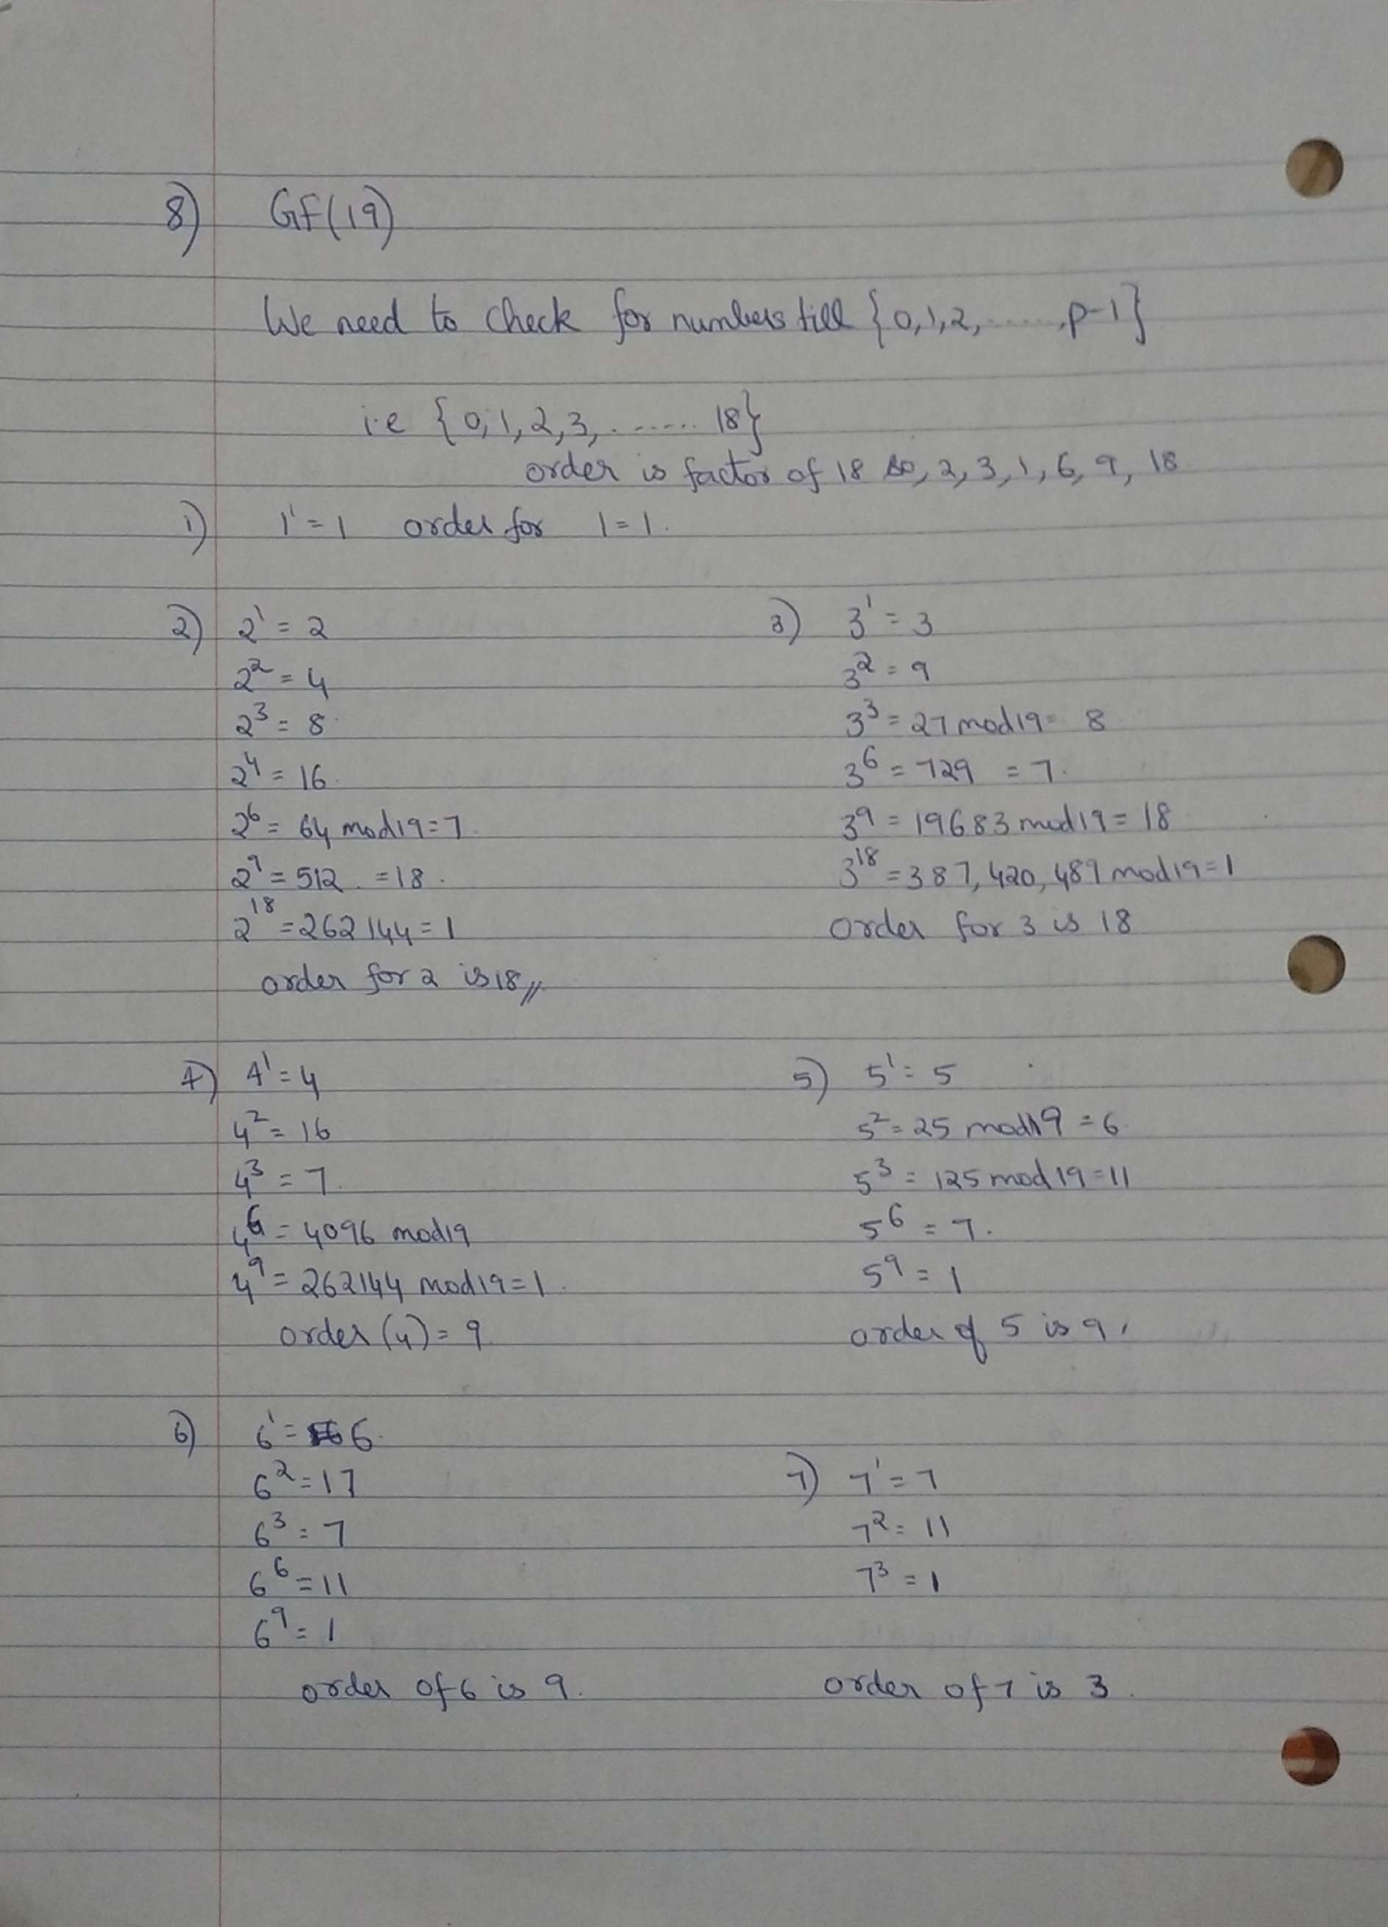
Problem 8
The primitive elements are :
Ans - 2,3,10,13,14,15,16,17

Slide 11
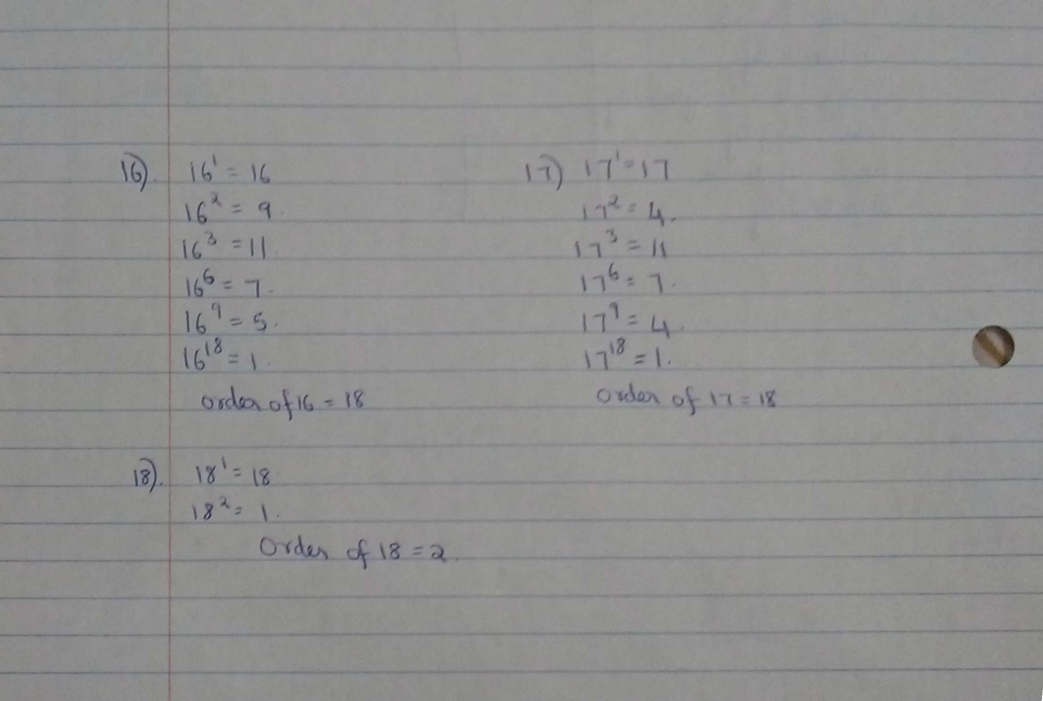
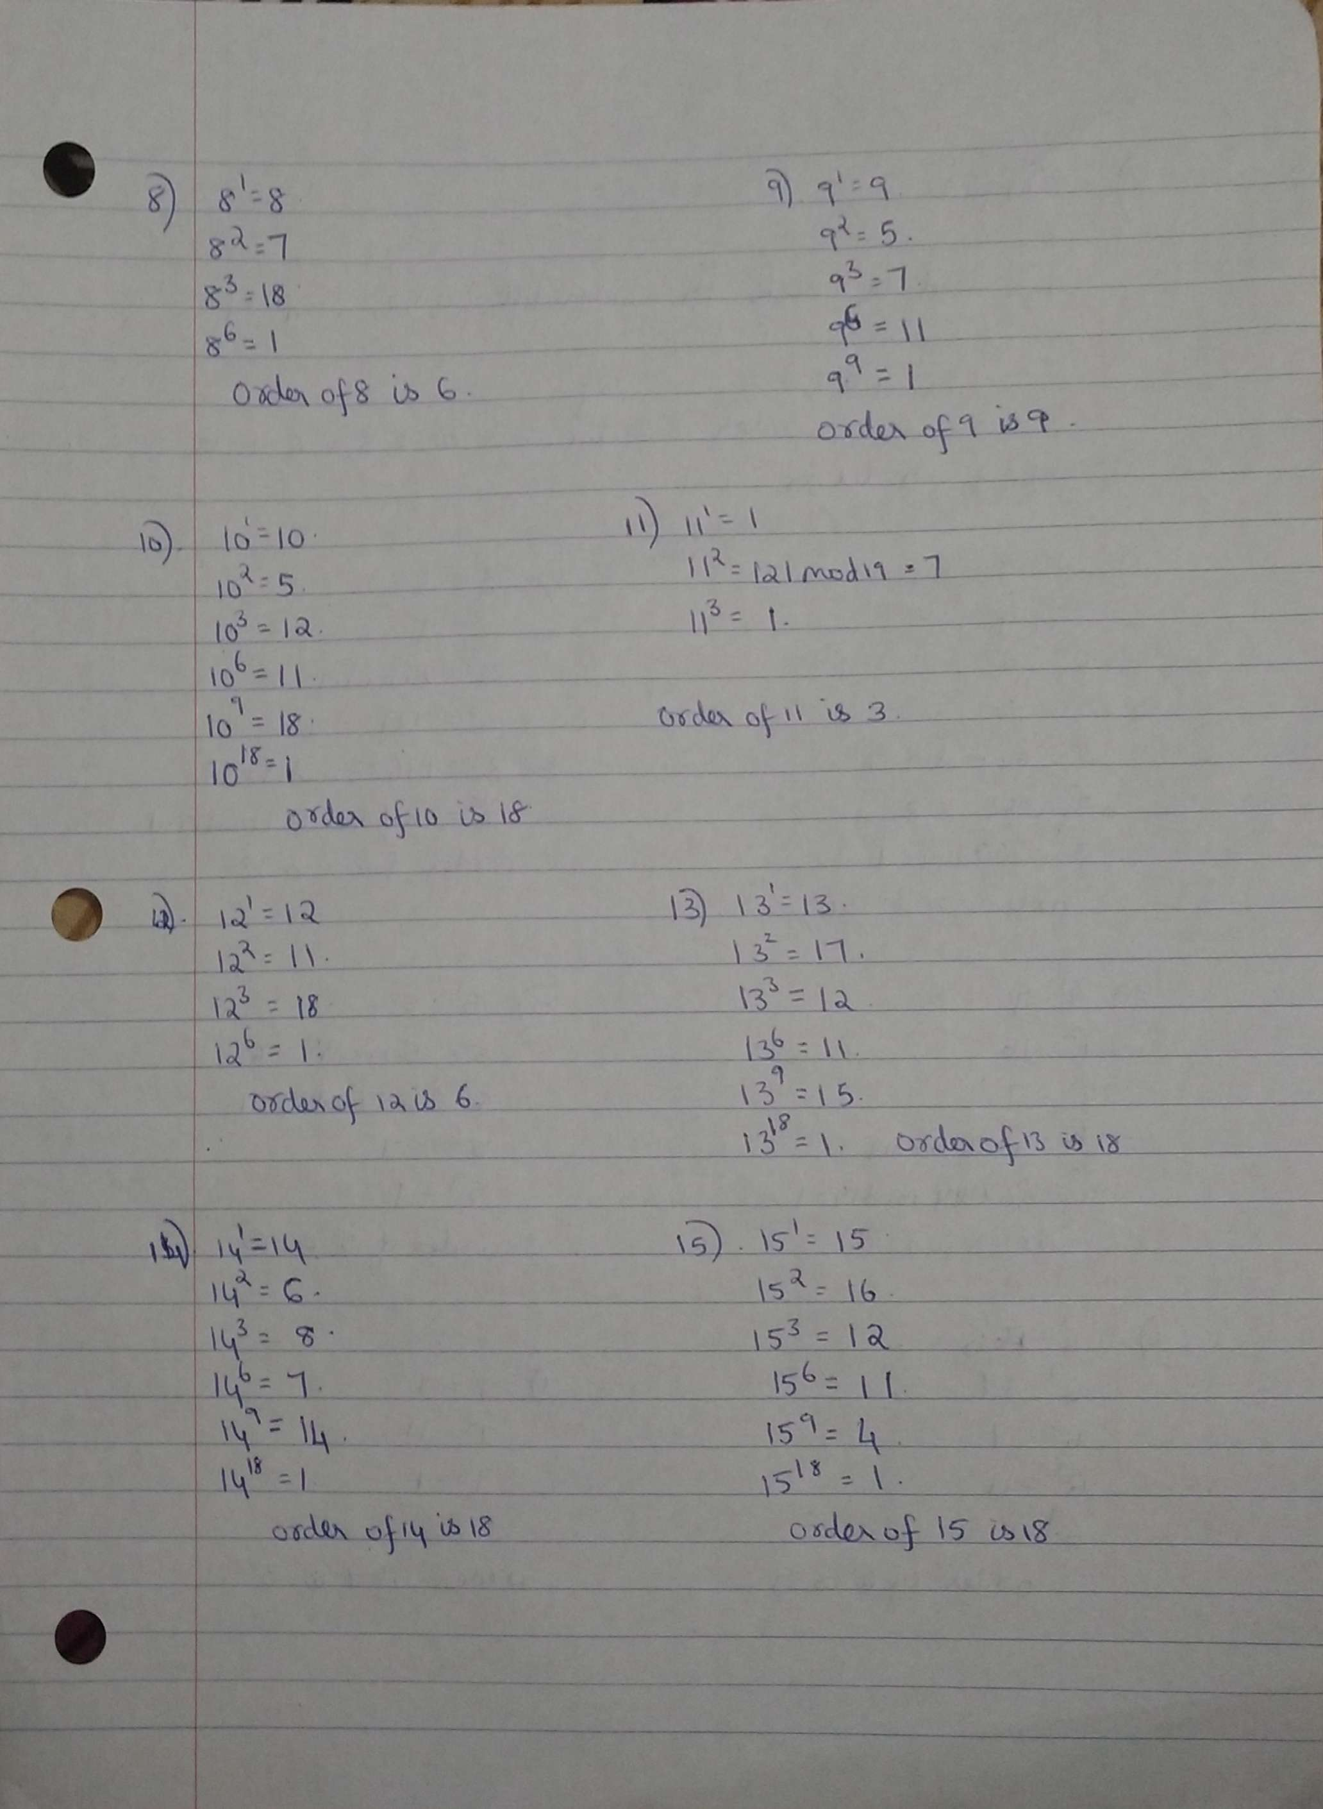

Slide 12
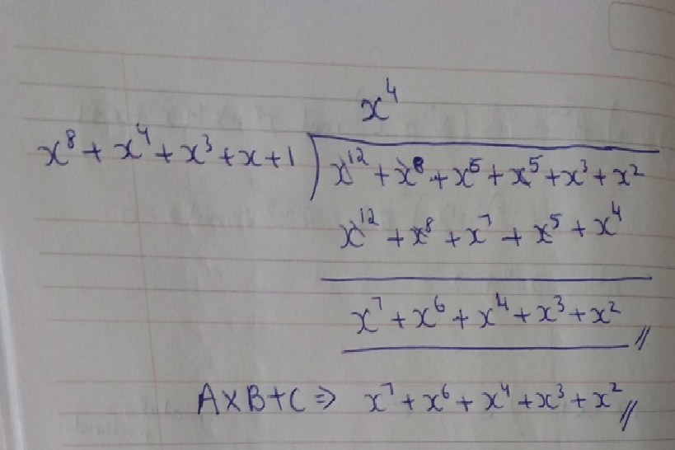
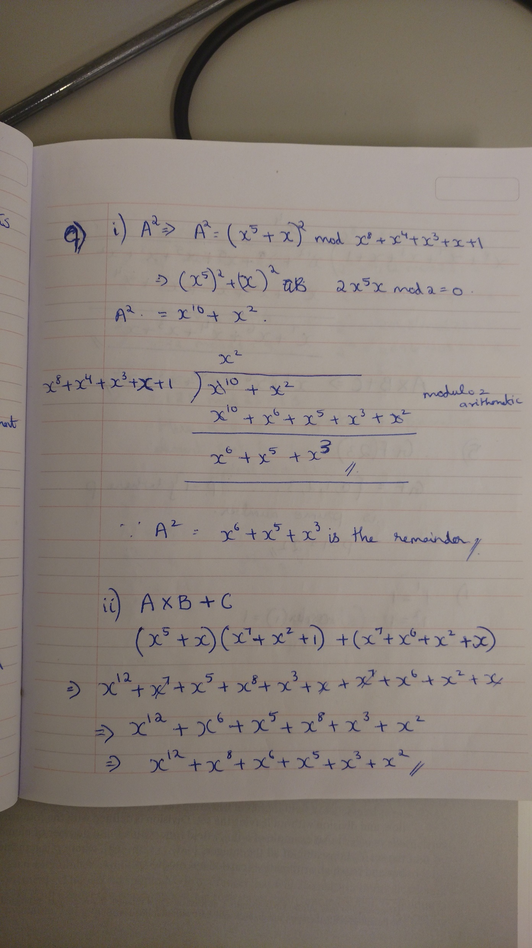
Problem 9

Slide 13
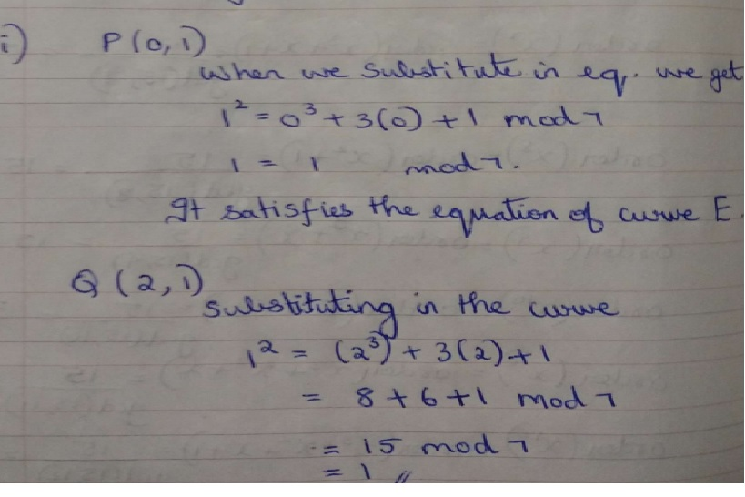
Problem 10(optional)

Slide 14
